Slide 1

introduction to singular value decomposition
SEPTEMBER 2020

Slide 2
based on the articles, papers, books of:
DANIELLA WITTEN
ANDREW GIBIANSKY
GILBERT STRANG
SONIA LEACH
GREGORY G UNDERSON

Slide 3

what I will assume about you

Slide 4

svd ≠ “just another matrix decomposition method”

Slide 5
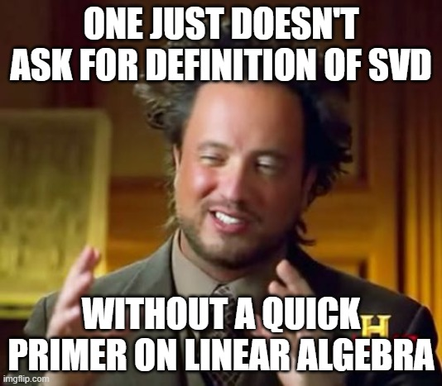
definition

Slide 6
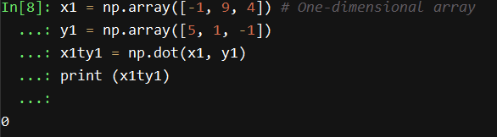
ORTHOGONALITY OF VECTORS
Using T to denote transpose of a matrix, vectors X and Y are orthogonal if
X^{T}Y = 0
…they are perpendicular

Slide 7
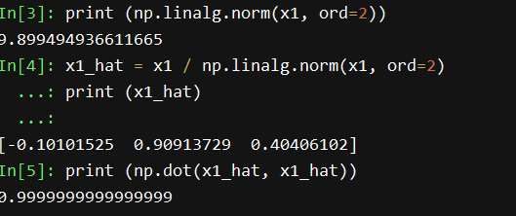
ORTHOGONALITY OF MATRIX
Using A to denote any square matrix such that its columns are mutually orthogonal with length 1. Also called the L2 norm
i.e. a column X is of length 1 when X^{T}X = 1
Then A is an orthogonal matrix and
A^{T}A = I (the identity matrix)

Slide 8
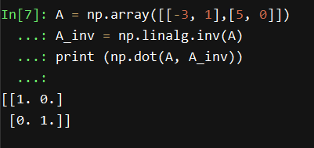
invertible matrix
A square matrix A is said to be invertible if the product of the matrix itself and its inverse is an identity matrix
A^{T}A = I
Note: Not all matrices are invertible.

Slide 9
diagonalization
A matrix A is said to be diagonalizable if we can rewrite it (decompose it) as a product…
A = PDP⁻¹
where P is an invertible matrix (i.e. P-1 exists, and D is a diagonal matrix, where all the diagonal elements are non zero, and off-diagonal are zero.
This definition really only makes sense for square matrices. A matrix that isn’t square is not diagonalizable,

Slide 10
diagonalization
Matrix multiplication of PD would mean the diagonal elements will scale the columns like…
PD = [a₁ s₁, a₂ s₂, …, a_{n} s_{n}]
If, A = PDP⁻¹
then…. AP = PD
Let’s define P by it’s columns (a₁, a₂, …, a_{n})
And D by its diagonal elements…
D =
s₁ 0 …. 0
0 s₂ …. 0
.
.
0 0 …. s_{n}

Slide 11



eigen values and eigen vectors
If, AP = PD
then, the columns of P must be eigenvectors of A and the values of the diagonal must be eigenvalues of A
Eigen = “Characteristic”
Original square
Vertical scale
Horizontal shear (area same)
https://www.youtube.com/watch?v=kwA3qM0rm7c

Slide 12
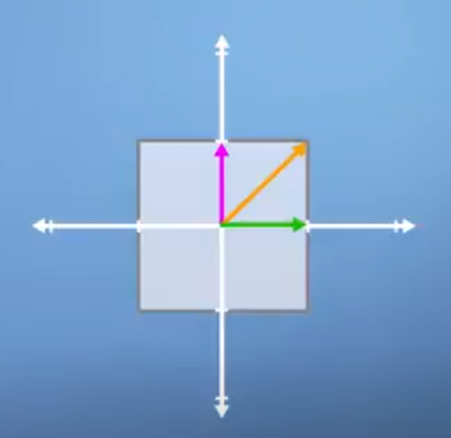
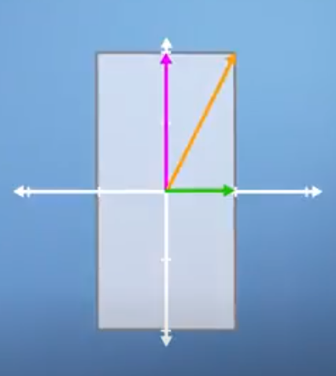
eigen values and eigen vectors
During these transformations, there are some vectors end up lying on same line as they started from, take for example the green and pink (horizontal and vertical are special)
They are “characteristic” of the original square or “eigen vectors”
Since the green vector has remained unchanged, it has eigen value = 1
And pink vector has scaled, so it has eigen value = scaled constant
Original square with 3 vectors
Vertical scale with 3 vectors where green line is exactly same, pink is scaled up, but orange scaled up and angle has increased
https://www.youtube.com/watch?v=kwA3qM0rm7c

Slide 13
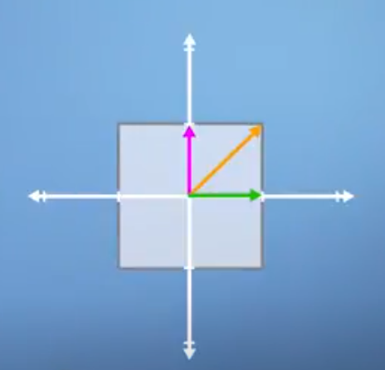
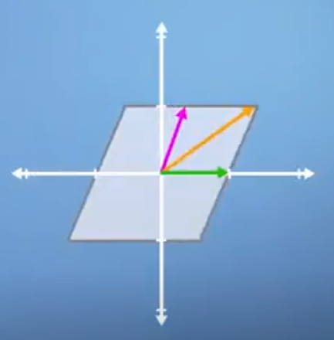
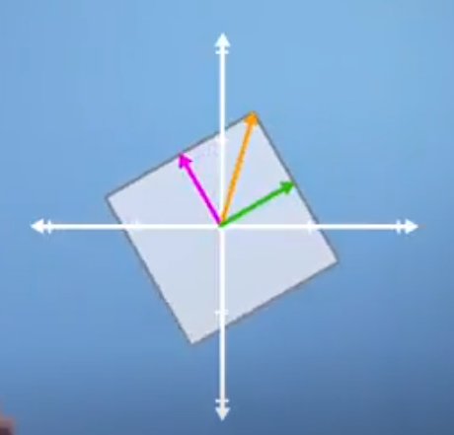
eigen values and eigen vectors
Generalizing it,
Horizontal shear with 3 vectors where green line is exactly same, rest of the two have changed
No eigen vectors, since all of them have changed
Original square with 3 vectors
https://www.youtube.com/watch?v=kwA3qM0rm7c

Slide 14
eigen values and eigen vectors
Let’s take a matrix A and a vector X
A = [[1, 2], [2, 4]]
X = [1, 1]
AX = [3, 6]
AX has been scaled and rotated compared to X
[3,6]
[1, 1]
https://www.youtube.com/watch?v=5UjQVJu89_Q

Slide 15
eigen values and eigen vectors
Let’s take a matrix A and a vector X
A = [[1, 2], [2, 4]]
X = [1, 2]
AX = [5, 10]
AX has been scaled but not rotated compared to X
hence X is the eigen vector of matrix A and scaling
factor = 5, is eigen value.
AX = 5. X
Generalizing, AX = λX
So there exists a vector X such that AX is only scaled by a factor of λ if X ≠ 0
Note if I multiply by another scalar, say c → c(AX) = λ(cX)
So when we talk about eigen vectors, we should think about normalizing to length = 1
Also –X will be an eigen vector!
[5, 10]
[1, 2]
https://www.youtube.com/watch?v=5UjQVJu89_Q

Slide 16
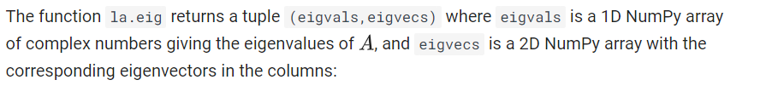
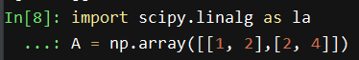
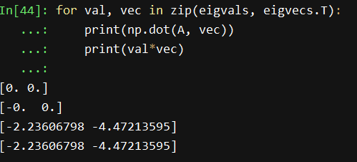
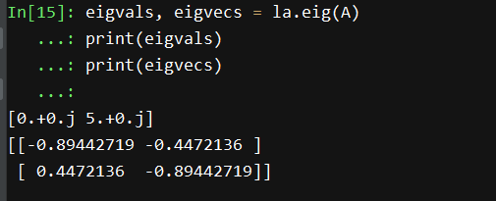
eigen values and eigen vectors
Question: Why is the eigvectors value different than previous page?
https://www.math.ubc.ca/~pwalls/math-python/linear-algebra/eigenvalues-eigenvectors/
https://matrixcalc.org/en/vectors.html#eigenvectors%28%7B%7B1,2%7D,%7B2,4%7D%7D%29

Slide 17
diagonalization
PD = [a₁ s₁, a₂ s₂, …, a_{n} s_{n}]
Since P is invertible, the eigenvectors form a basis.
But note, not all matrices have eigen vectors that form basis (since all matrices not diagonalizable)!
https://www.quora.com/What-is-the-relationship-of-eigenvectors-to-basis-vectors#:~:text=Eigenvectors%20must%20be%20formed%20from%20a%20linear%20combination%20of%20the%20basis%20vectors.&text=n%20linear%20independent%20vectors%20are,be%20factorized%20into%20linear%20factors.

Slide 18
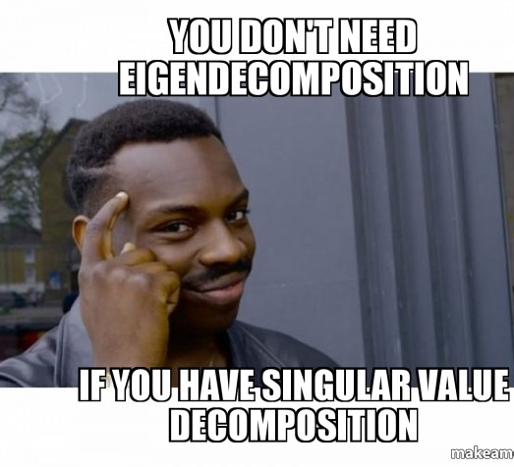
we will not go into details of eigen value and vector calculation

Slide 19

singular value decomposition
SVD is nothing but diagonalization in a more general sense.
However, the flaw it fixes is that….
SVD applies to matrices of any shape!
To get SVD of any matrix A, A^{T}A is symmetric (check yourself!)

Slide 20
SYMMETRIC MATRIX PROPERTY
Now for any symmetric matrix A (A = A^{T}), one of the many interesting properties is that their eigen vectors form an orthonormal basis….in other words linearly independent (real) and orthogonal!
PROOF:
Let β, ω be the eigen values V₁ and V₂ & of a symmetric matrix A, and let β ≠ ω
Hence, A V₁ = β V_{1,} dot product by V₂ we get A V₁ .V₂ = β V₁ .V₂
Reversing the procedure, A V₂ .V₁ = ω V₂ .V₁
A V₁ .V₂ = A V₁ V₂ ^{T} = (A V₁ V₂ ^{T} )^{T} since A V₁ V₂ ^{T} is a 1x1 matrix and is equal to its transpose
(A V₁ V₂ ^{T} )^{T} = A^{T} V₁^{T}(V₂ ^{T} )^{T} = A V₂ V₁^{T} = A V₂ . V₁

Slide 21
PROOF CONTD.
A V₁ .V₂ = β V₁ .V₂ = A V₂ . V₁ = ω V₂ .V₁
Or, β V₁ .V₂ = ω V₂ .V₁
Hence, (β – ω) V₁ . V₂ = 0
Assuming as before that the eigen vectors have length 1, and orthogonal (from above)
We have proved that eigen vectors V₁ and V₂ form an orthonormal basis for A

Slide 22
SINGULAR VALUE DECOMPOSITION
With slight change of notation from previous example, Let X be the eigen vector with eigen values β of matrix A
A singular value decomposition of an m x n matrix A is any factorization of the form:
A = UΣV^{T}
^{where,}
U is an m x m orthogonal matrix
V is an n x n orthogonal matrix
Σ ^{is a m x n diagonal matrix}

Slide 23
SINGULAR VALUE DECOMPOSITION
Let z = √ β and let, r = A X / z
The diagonal matrix Σ will have z as values along the diagonal (padded with zeroes if needed)
The U matrix will have r as columns
The V matrix will have X as columns
UΣ = z r = z A X / z = AX
Hence, UΣV^{T} = AXX^{T}
Since, X matrix contain the eigen vectors of A, they form an orthonormal basis!

Slide 24

SINGULAR VALUE DECOMPOSITION
Since, X matrix contain the eigen vectors, let’s say, X_{i} and X_{j} of A, they form an orthonormal basis!
They have to be orthogonal i.e. for i ≠ j, X_{i} X_{j}^{T} = 0
They have unit length i.e. for i = j, X_{i} X_{i}^{T} = 1
Therefore,
UΣV^{T} = AXX^{T} = AI = A

Slide 25
SINGULAR VALUE DECOMPOSITION
UΣV^{T} = AXX^{T} = AI = A
Thus, singular value decomposition in its most common form:
for any matrix A, we can rewrite it as the product A=UΣV^{T} of three matrices, U, Σ, and V^{T}, where U and V have orthonormal columns and Σ is a diagonal matrix (the entries of which are known as singular values).

Slide 26
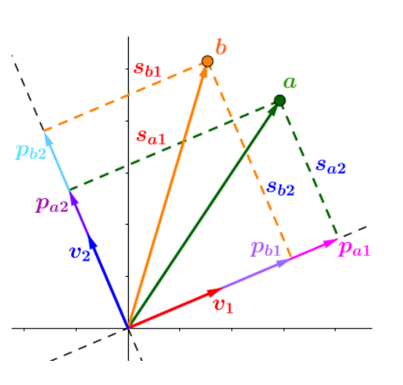
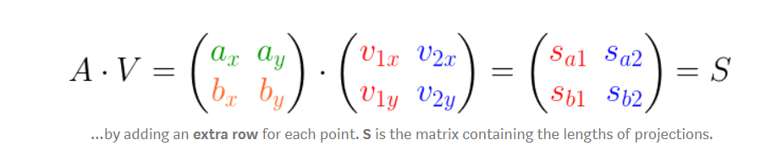
alternatively, you can think in these terms
UΣV^{T} = A
Matrix A, is expressed as two vectors a and b
A = [[a₁, a₂], [b₁, b₂]]
Projections of vector A on two axes U and V
https://towardsdatascience.com/svd-8c2f72e264f/

Slide 27
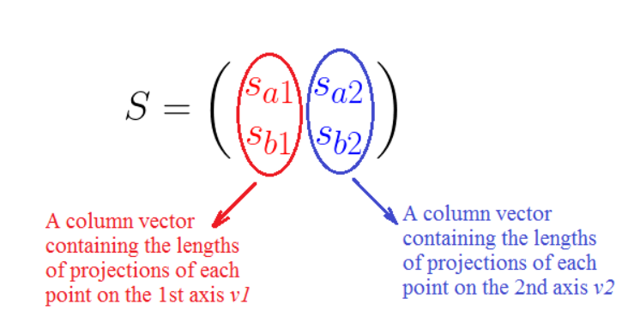
alternatively, you can think in these terms
S as shown here is nothing but the length of projections of A and B vector into the 2 axes
If we normalize these column vectors to unit length....then we get
https://towardsdatascience.com/svd-8c2f72e264f/

Slide 28
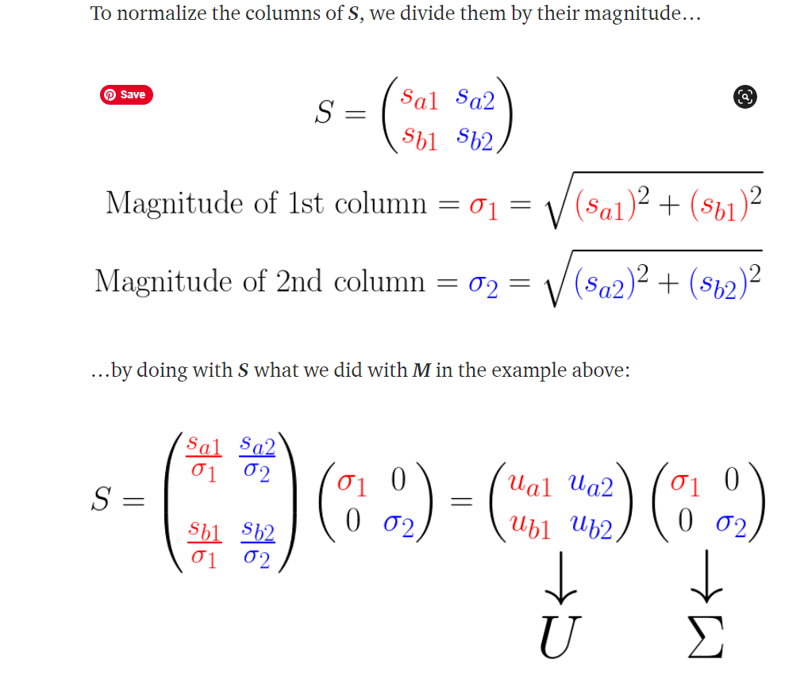
alternatively, you can think in these terms
Matrix S, is expressed in terms of:
U represents the lengths of projections on a rotated axes with length 1
Σ represents a square root of the sum of squared of projection lengths → higher the values here, closer the points to that axes.
https://towardsdatascience.com/svd-8c2f72e264f/

Slide 29
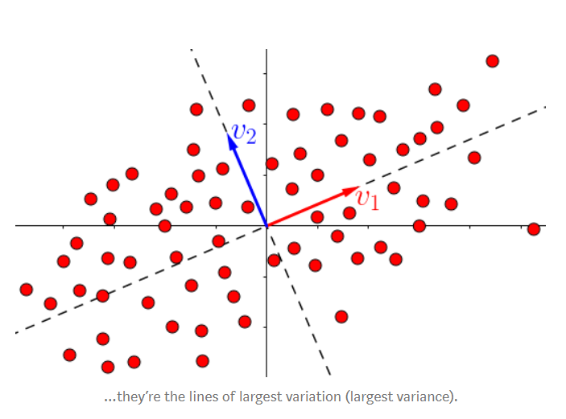
alternatively, you can think in these terms
The algorithm of finding SVD, actually chooses the projection directions of V based on the….
Principal Components of matrix A
So, the rotation is actually chosen based on where the data is projected on the plane of maximum variance
And hence Σ consists of the eigen values (or singular values sorted from highest to lowest)
https://towardsdatascience.com/svd-8c2f72e264f/

Slide 30


Slide 31
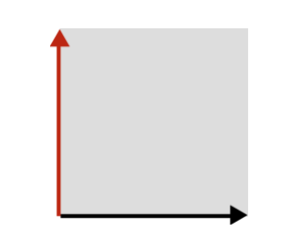
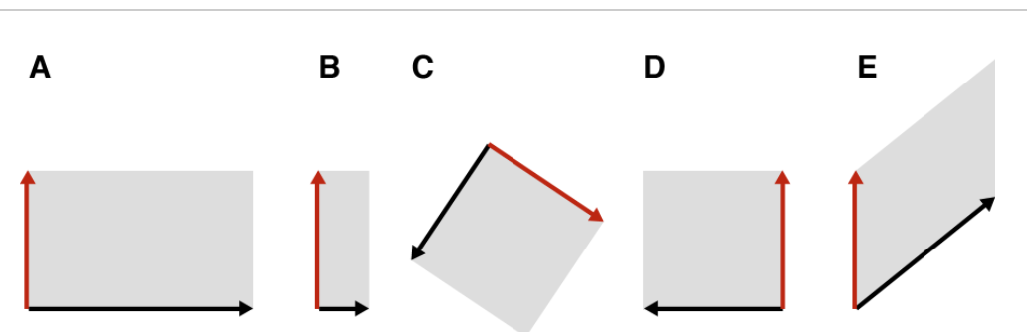
INTUITION OF SVD:
Imagine a square, like L shaped
This can be manipulated in many ways… (keep in mind, we need a linear transformation i.e. a straight line on the space before, remains a straight line on the space after!
Stretch
Compress
Rotate
Flip
Shear
http://gregorygundersen.com/blog/2018/12/10/svd/

Slide 32
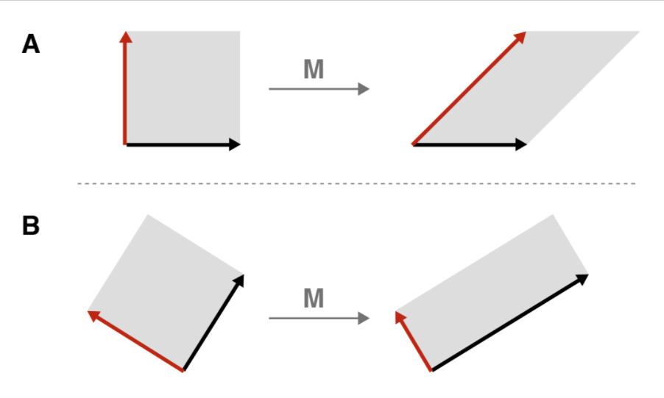
cool mathematical fact
Any transformation on this square (provided it is linear), can be thought of as – stretching, compress, flipping – if and only if we properly rotate the square before performing the transformation
Let’s imagine a hand is pushing from top left corner directed towards the right
Before rotation, all we get is a shear.
But if we rotate and then transform, we get a stretched and compressed transform
http://gregorygundersen.com/blog/2018/12/10/svd/

Slide 33
essence of svd
Any linear transformation can be thought of as simply stretching or compressing or flipping a square, provided we are allowed to rotate it first.
The transformed square or rectangle may have a new orientation after the transformation i.e. angle may change
http://gregorygundersen.com/blog/2018/12/10/svd/

Slide 34
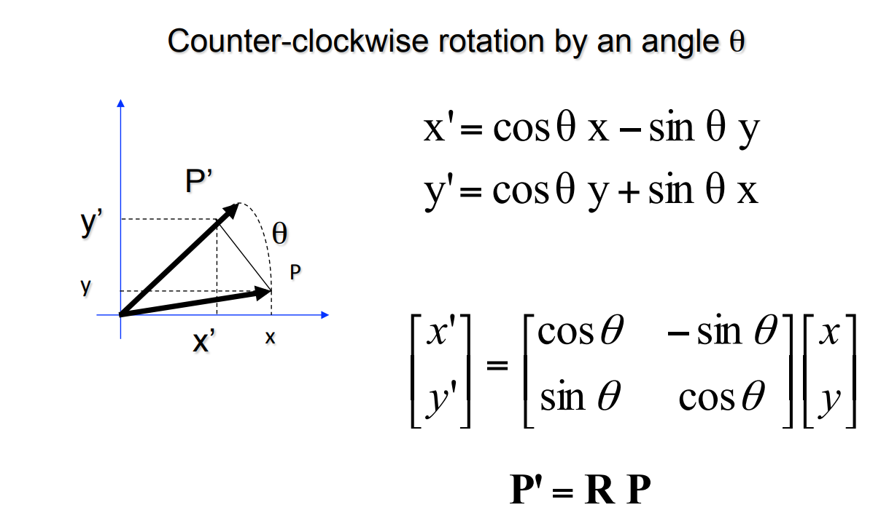
INTUITION OF SVD: THINK OF ROTATION
http://vision.stanford.edu/teaching/cs131_fall1516/lectures/cs131_linalg_review.pdf

Slide 35
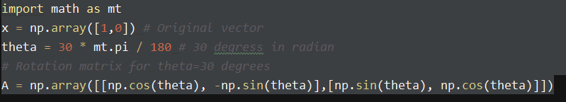
ROTATION MATRIX
Assume X = [1, 0] is rotated by an angle 30 degrees so that we get resultant vector
Y = Rx, where R is the rotation matrix described in previous page
http://gregorygundersen.com/blog/2018/12/10/svd/

Slide 36
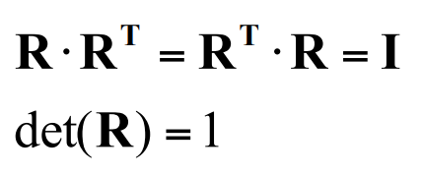
ROTATION MATRIX
Transpose of a rotation matrix, produces a rotation in opposite direction
The rows of the rotation matrix are always mutually perpendicular i.e. orthogonal unit vectors
UΣV^{T} = A
U and V are nothing but resultant of rotation matrices multiplied by the original vector (axes), whereas Σ is a scaling matrix (scales the dimension by a factor).

Slide 37
geometrically*
ROTATION → SCALING → ROTATION
* for square matrices. For non-square, this loses meaning

Slide 38


Slide 39
why is this even useful? – part 1
Let’s imagine we have a matrix, any matrix X with 1 pair of vectors (2d)
If you run a linear regression, is an approximation of the first column of U and V
X ~ U₁Σ₁₁V₁^{T}
…and as you keep adding another pair of vectors, this generalizes…
X ~ U₁Σ₁₁V₁^{T} + U₂Σ₂₂V₂^{T} + ….. + U_{k}Σ_{kk}V_{k}^{T}
Sales
Promo Flag | Location

Slide 40
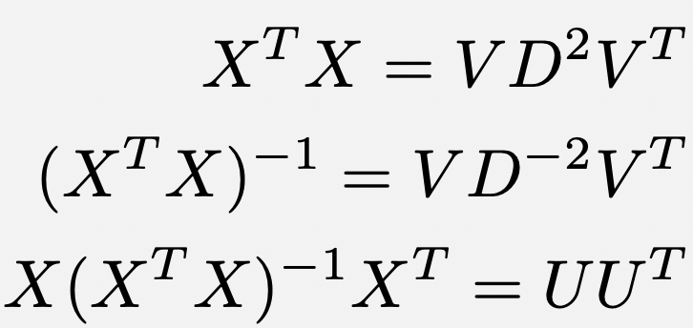
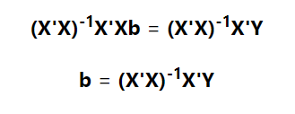
why is this even useful? – part 1
Let’s imagine we have a matrix, then it can be shown that….
The first 2 don’t include U
The last one doesn’t include V or D (same as Σ).
We use the 1st and 2nd for our linear regression estimates!

Slide 41
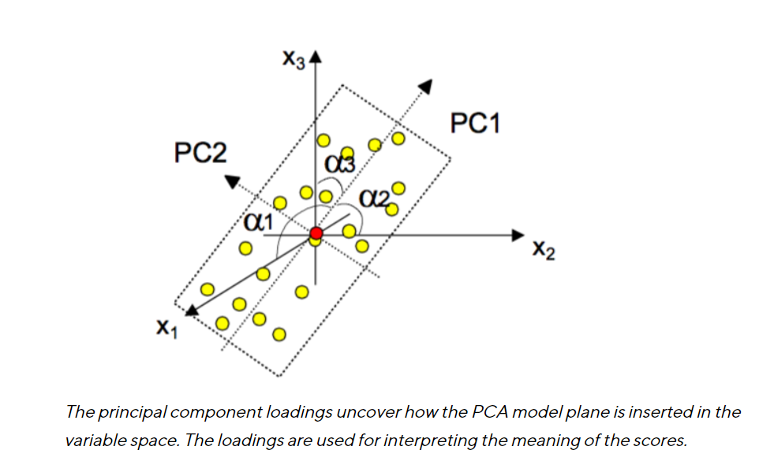
why is this even useful? – part 2
SVD is already doing PCA as described before!
V captures the loading vectors
U captures the score vectors (basically the value of the projections on V, as seen before)
Once the X matrix is scaled (unit length a.k.a ‘variance’)
https://blog.umetrics.com/what-is-principal-component-analysis-pca-and-how-it-is-used

Slide 42
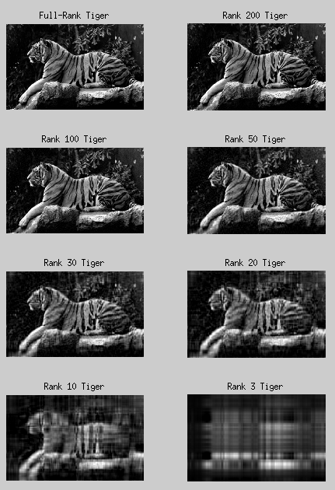
why is this even useful? – part 3
SVD is also doing data compression or dimensionality reduction!
Suppose X has rank 1000. This takes lot of memory.
Can we approx. X with lower rank, say 100 or 20?
Turns out, yes! Just take the 20 top singular values in Σ
Also, the sum of first 20 singular values/sum of all singular values ~ % information contained!

Slide 43
why is this even useful? – part 4
Imputation of missing values.
Suppose there are elements missing in X.
Fill the missing elements using the column mean
Then choose a rank (i.e. # of factors to describe data) and compute SVD
Replace missing elements with the singular values of same rank.
4) Repeat until your answer does not change!

Slide 44
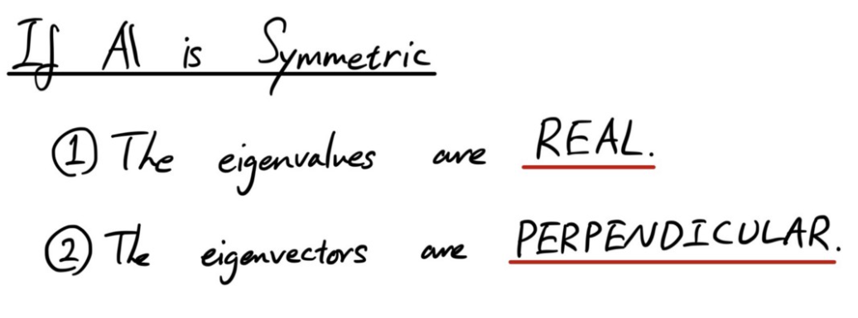
why is this even useful? – part 5
SVD is also doing eigen decomposition.
Say A is a symmetric matrix
Then A is..
A = X^{T}X for some X and we know…
Σ contains the eigen vectors of A
Singular values are nothing but the square root of eigen values
https://medium.com/sho-jp/linear-algebra-101-part-7-eigendecomposition-when-symmetric-4cd41d38269e

Slide 45
why is this even useful? – part 6
If we need to check for multi-collinearity before running a model….
Check, the top most singular value and divide by singular value of another column
Σ ₁₁/ Σ _{kk} → if huge they are multi-collinear!
https://towardsdatascience.com/ridge-regression-and-multicollinearity-d8a3e06efce8

Slide 46
why is this even useful? – part 7
For any matrix, X if we look at non zero singular values = that gives the rank of the matrix.
https://towardsdatascience.com/ridge-regression-and-multicollinearity-d8a3e06efce8

